Slide 2



Situation Overview
MP Materials’ dominance within US rare earth mineral production provides an opportunity to take advantage of a growing industry
Market Narrative
Strategic Partnerships (Corporations & Government)
The Market recognizes MP as America's critical minerals hedge with the only government contracted rare earth mine in the Western Hemisphere at Mountain Pass, positioned as a strategic alternative to Chinese supply chains controlling 90% of global processing.
The Market views MP's blue-chip customer commitments as de-risking execution, with Apple's $500M magnet supply agreement and GM's long-term offtake providing contracted revenue visibility that validates commercial viability before full 10X capacity ramp.
“We initiate coverage with a Buy rating as MP Materials remains the largest producer of rare earth materials in the Western Hemisphere. As the company completes the shift from raw extraction to full-scale magnet manufacturing, we anticipate robust revenue and EBITDA growth, unlocking significant margin leverage.” ~ Goldman Sachs Analyst Brian Lee
Over $2 billion total has been invested into MP from outside clients, demonstrating visible contract demand and likely imminent expansion
Dec. 2021: MP and General Motors, the largest domestic automaker, entered an exclusive agreement to invest in American-made rare earth magnets. GM plans to make 50% of its plants EV-capable by 2030 and grow EV revenue to 90 billion by 2030.
Jul. 2025: MP and Apple, the second-largest tech company globally, entered a 4-year, $500 million deal to purchase magnets for its consumer products. Apple also provided $200 million for MP to invest in sustainable recycling technology.
Oct. 2025: MP and the DoD entered a $400 million deal to establish domestic rare-earth production. A $110/kg price floor on NdPr products insulates MP from market risk and establishes a guaranteed $140 million in annual EBITDA for the next 10 years.
2

Slide 3
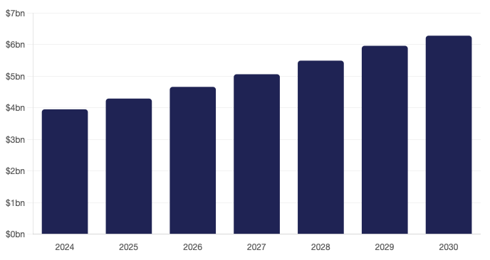
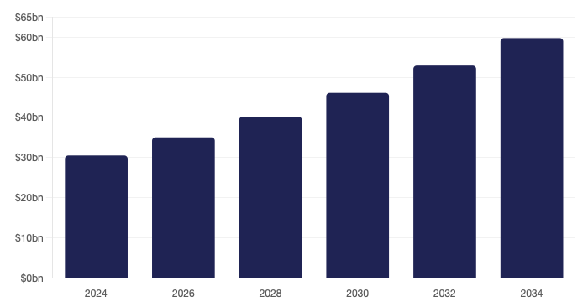
Rare Earth Elements & Advanced Magnet Industry Overview
Strategic minerals market accelerating demand across electrification and AI Infrastructure amid supply chain realignment
Global Rare Earth Mineral Elements Market ($bn)
Global NdFeB Permanent Magnets Market ($bn)
≈
≈
The global rare earth market is projected to reach $6.28 billion by 2030, growing at 8.6% CAGR. With increasing EV adoption, defense modernization, wind energy expansion, and AI data center buildout requiring high-performance cooling systems, demand for NdPr magnets continues to accelerate.
The NdFeB magnets market was valued at $30.54 billion in 2024 and is projected to be $59.74 billion by 2034, growing at a CAGR of 6.94%. This near-doubling shows market growth attributed to the rising adoption of electric vehicles, wind energy systems, and high-efficiency motors that rely on NdFeB magnets for compact design and superior performance
3

Slide 4
Investment Thesis Summary
Rare Earths company poised for strong performance, with favorable market demand and exclusive client partnerships.
Structural NdPr Demand Growth
Structural NdPr deficit every year of our 10-year DCF (68k MT shortage by 2035, 3x magnet REE demand growth per McKinsey).
Each EV requires 1-3 kg NdPr with the International Energy Association. projecting 55M+ annual EV sales by 2035, showing how demand is physically locked in.
MP is the only U.S producer shipping into this gap, capturing seven full years at 10,000 MT run-rate (2029-2035) post-2028 commissioning.
Current Price: $60.99
Price Target: $71.80
Implied Upside: 17.7%
Exit EBITDA Multiple: 11.7x
Policy + Contracts: Downside Protection
MP operates with a $110/kg NdPr Price Protection Agreement that guarantees high margins despite predatory pricing by China.
Federal law prohibits the DoD from obtaining magnets from China. As the only end-to-end domestic producer, MP Materials holds a de facto monopoly over the U.S. defense industrial base's magnet requirements.
The US government is MP's largest strategic partner with the DoD taking a $400M equity stake. Backing by National Security provides a lower cost of capital and support not available by any peer.
DCF GG: $69.4
DCF Exit: $71.8
DCF Exit Multiple: 11.7x
Comps EBITDA: ($6.9)
Comps EBIT: ($20.0)
Vertical Integration Towards Margin Expansion
Established monopoly on US rare earth mining; ownership of 15% of global market.
NdPr production increased by over 101% from 2024 to 2025 and magnet production is being scaled to 10,000+ MT by 2030.
MP is creating a totally self-sufficient supply chain that creates unmatched pricing power and will be challenging for domestic competitors to match.
4

Slide 5
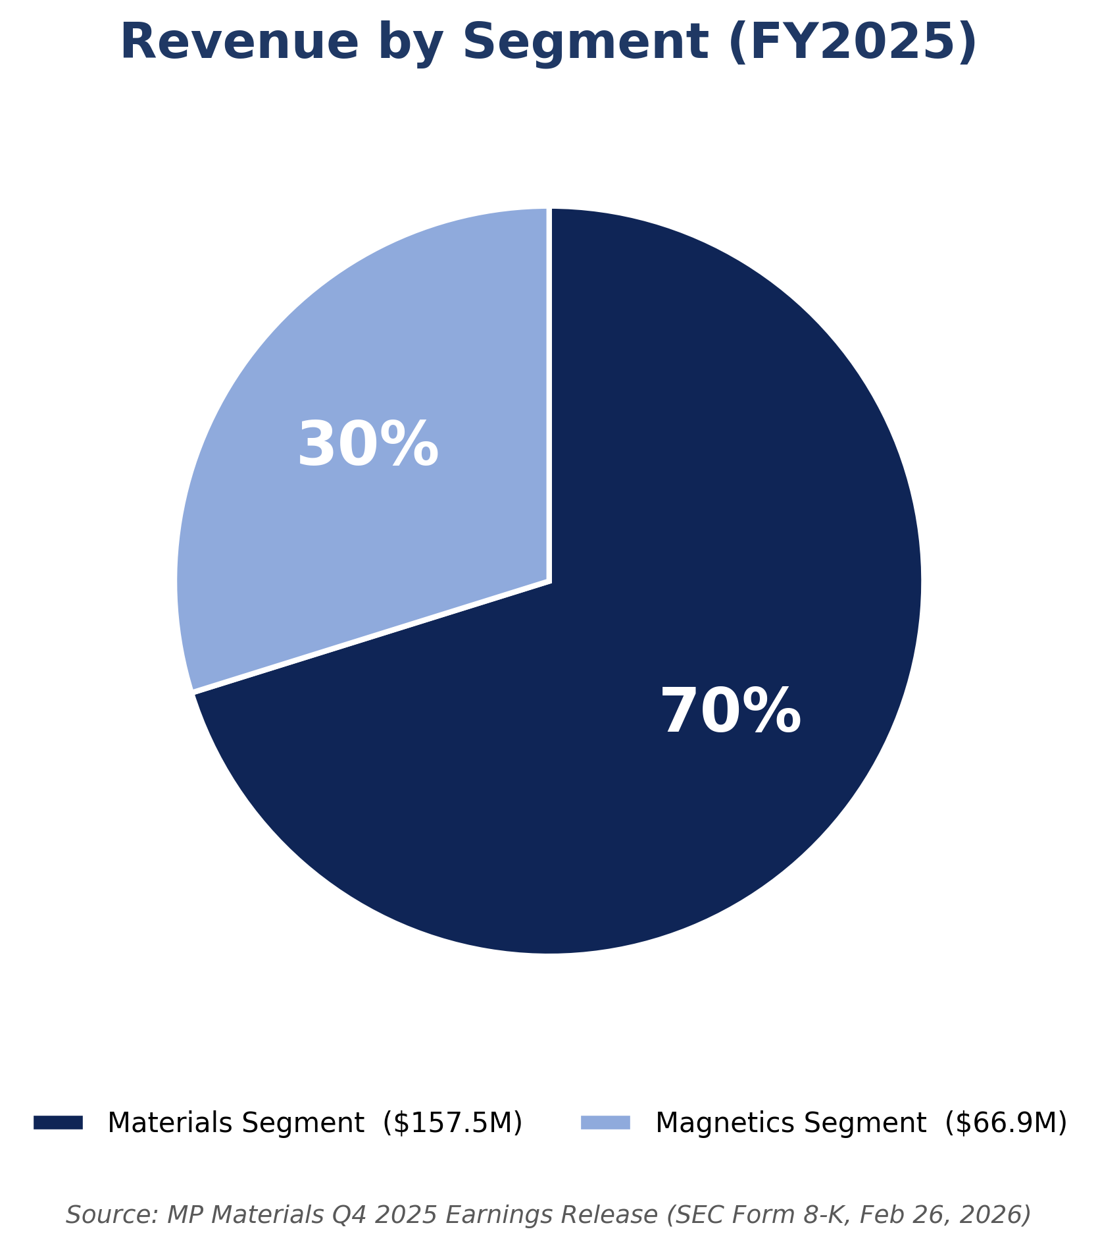
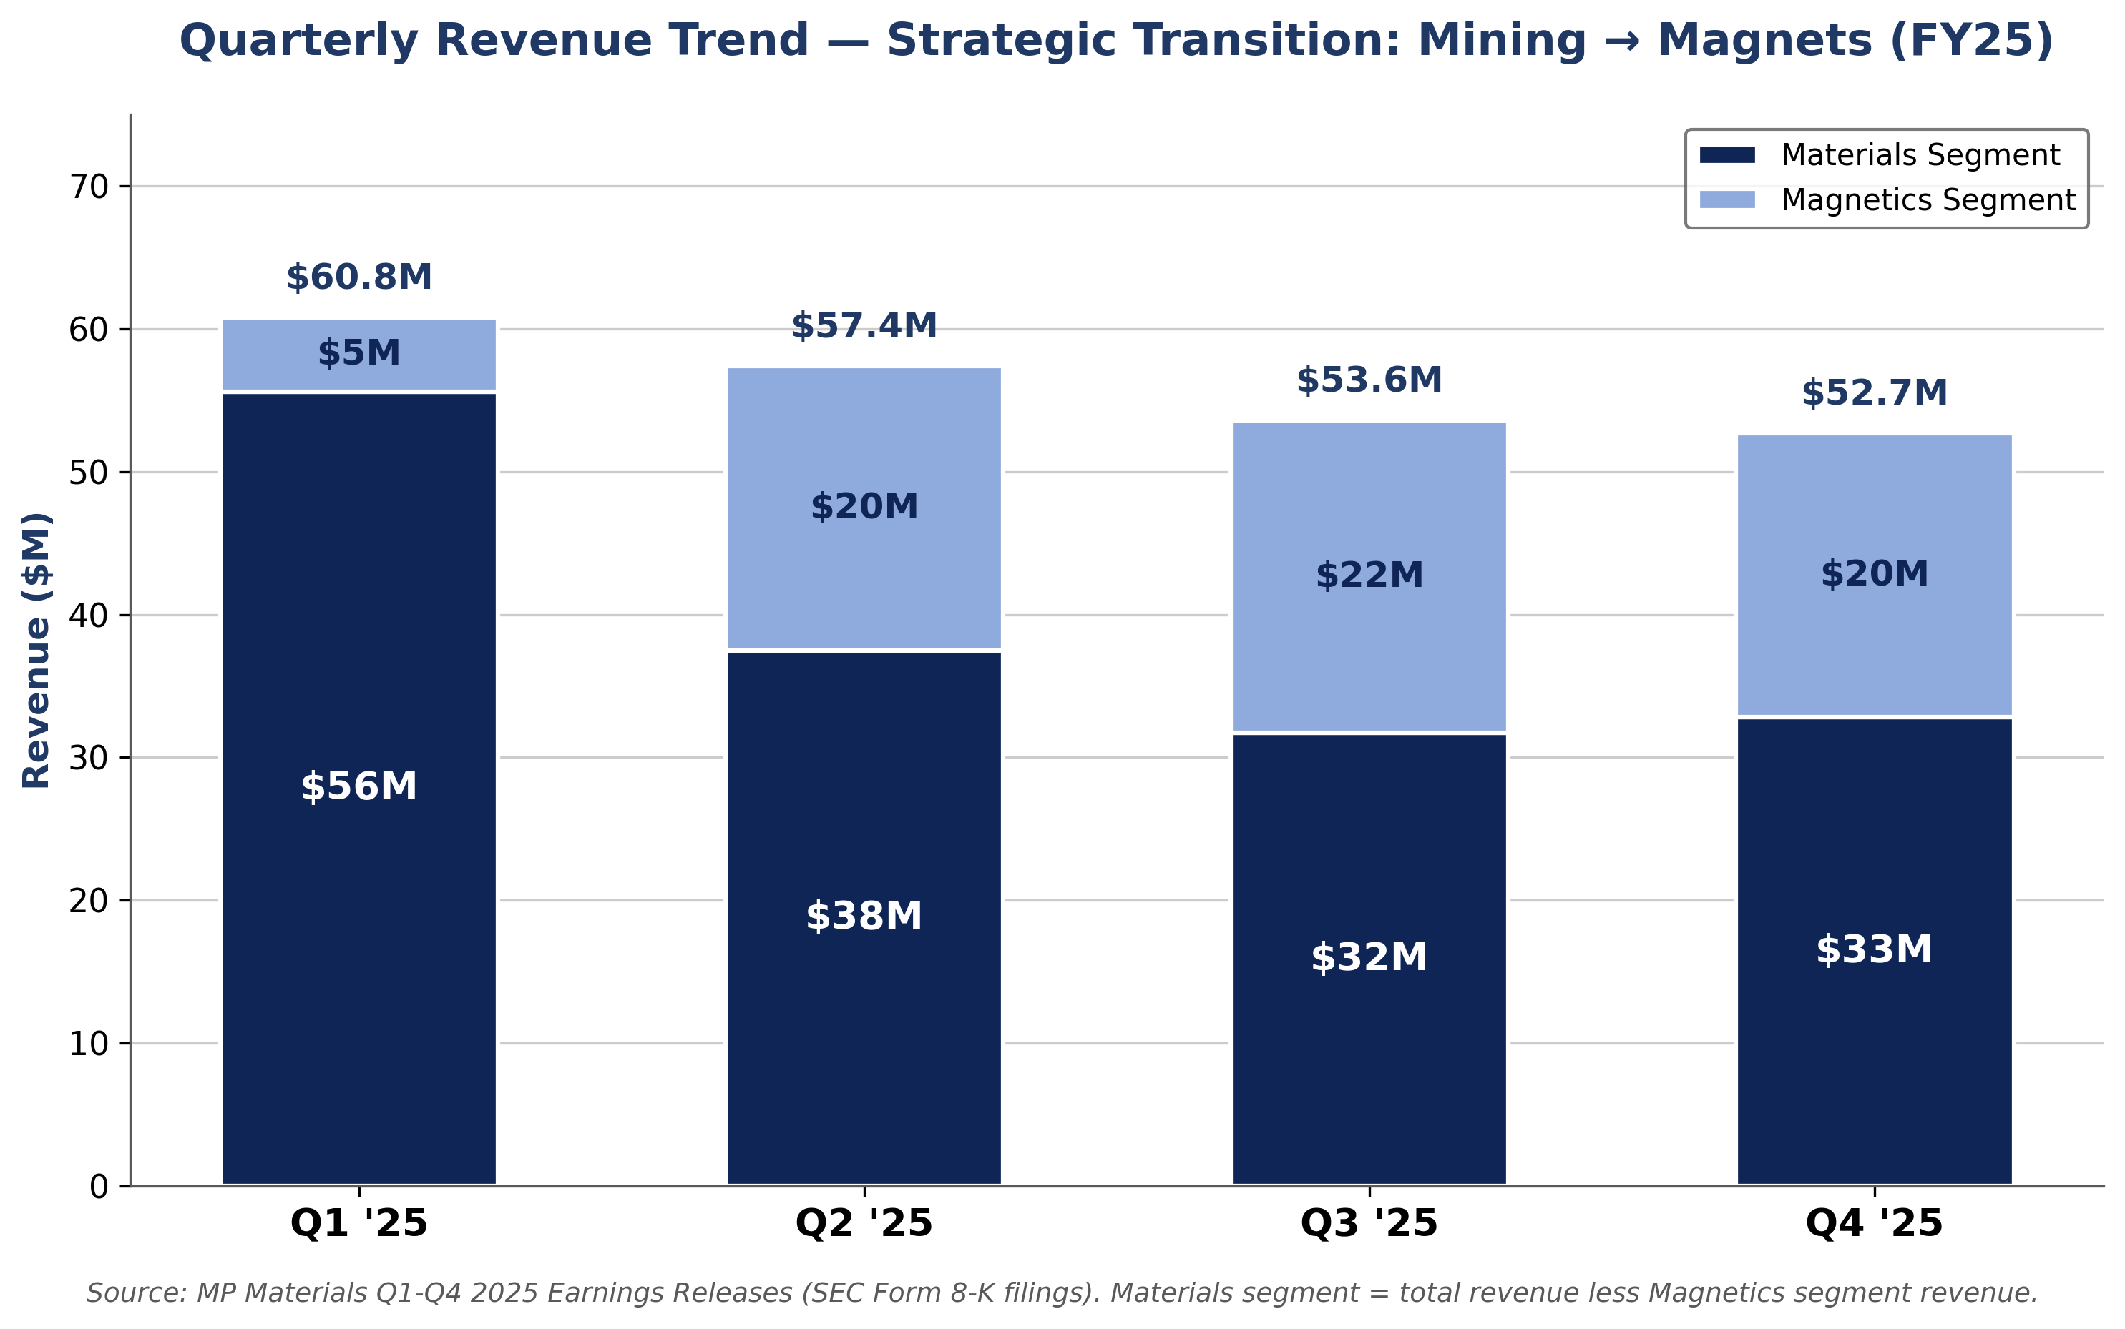
Company Overview
Overview of MP Materials
Product Offering
MP Materials primarily produces Neodymium-Praseodymium (NdPr), the critical rare earth element for high-strength permanent magnets. These magnets provide the essential torque and efficiency required for electric vehicle motors, wind power turbines, and precision-guided defense systems.
Competitive Landscape
The rare earth industry is dominated by Chinese state-linked producers (controlling ~90% of processing). MP Materials is the sole scaled Western alternative with a fully domestic U.S. supply chain.
Key Statistics
Revenue by Segment
Market Capitalization: $10.84Bn
Current Stock Price: $60.99
LTM Revenue: $224.44M
Full FY26 Guidance: $463M
LTM Adjusted EBITDA: $11.42M
LTM Net Loss: $(85.87)M
Cash and ST Investments: $1.83Bn
10%
35%
55%
Source: MP Materials Q4 2025 Earnings Release (SEC Form 8-K, Feb 26, 2026)
Quarterly Revenue Trend
FY-25 Overview
Strategic Transition: Mining to Magnets (FY25)
Revenues
FY25 Revenue: $224.4M
YoY Growth: +10%
Q4'25 Revenue: $52.7M
Q4'25 Net Income: $9.4M
Key Customer Anchors
GM – binding NdPr/magnet offtake
​
Apple - $500M recycled magnet deal
​
U.S DoD - $400M equity + $110/kg NdPr floor
​
​
Margins
Q4'25 EBITDA Margin: 74.4%
FY25 EBITDA Margin: 5.1%
FY25 Net Loss: (38.3%)
FY24 EBITDA Margin: (24.6%)
​
​
Key Insights
Headline revenue fell as MP halted China concentrate sales by Magnetics segment scaled 4x (Q1 to Q4).
Q4 2025 = first profitable quarter ($9.4M net income), aided by $51M PPA income.
Source: MP Materials Q1-Q4 2025 Earnings Release (SEC Form 8-K filings)
5

Slide 6
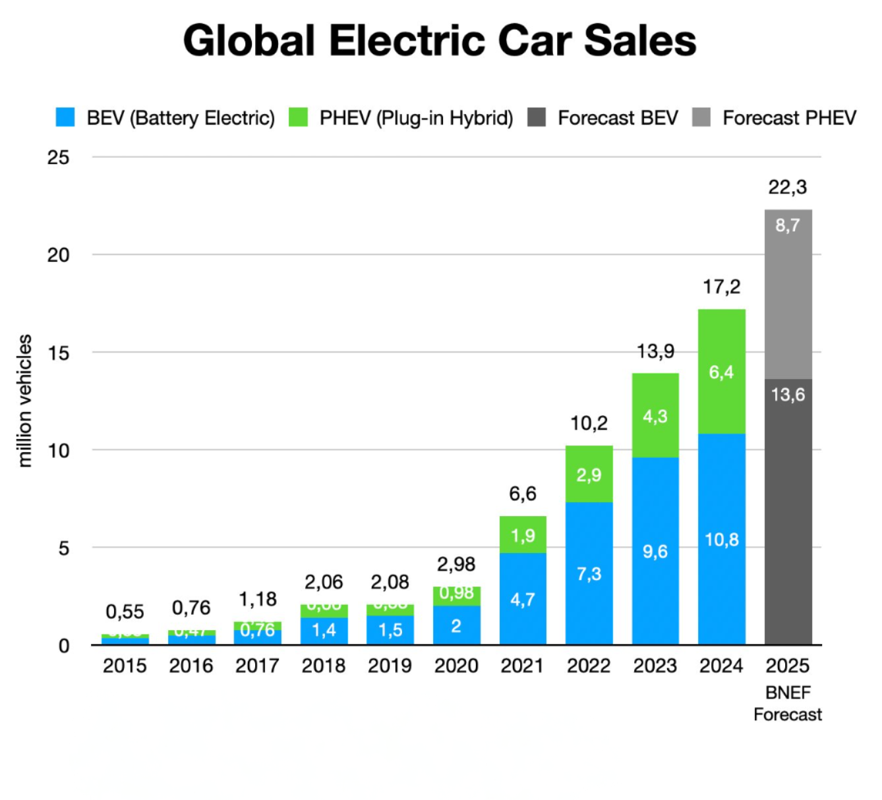
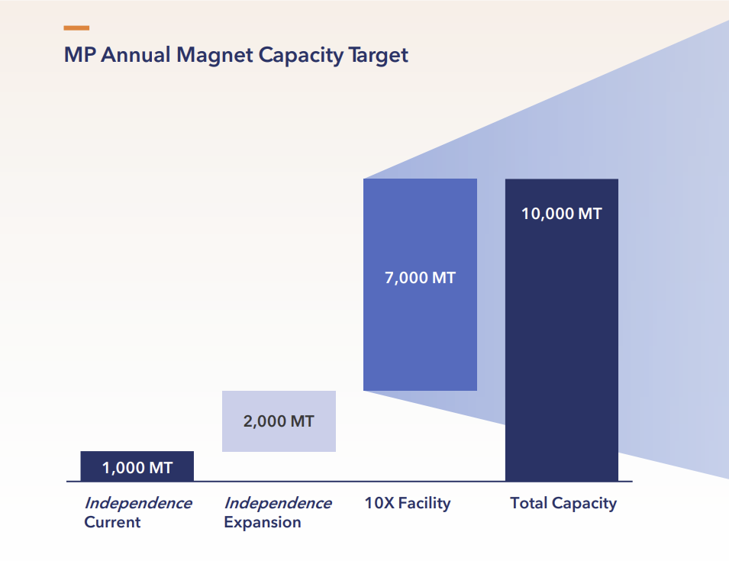
Investment Driver I – EV Traction Motor Demand
Global EV sales drive a structural NdPr supply deficit through 2030 while MP Materials is the only U.S producer shipping into this gap.
Direct Revenue Leverage to NdPr
MP is the most liquid equity proxy for North America NdPr exposure.
Revenue correlates directly with NdPr oxide pricing
Q12026 guidance: +20% sequential NdPr production growth
1
2
EV Demand Outstrips Global NdPr Supply
MP Materials as the Only U.S Beneficiary
Global EV Sales Trajectory
EV Motor Intensity
MP's Materials segment revenue moves directly with NdPr pricing; furthermore, EV demand growth is the primary driver of the NdPr price curve.
Each EV traction motor requires 1-3 kg of NdPr.
Permanent magnet motors retain more than 70% share of EV drive motors over the next decade.
Tesla pivoted back to permanent magnets in Model 3 because the substitution for it failed at scale.
Production Ramp Inside the Deficit Window
2025 actual: 2,599 MT NdPr oxide (+101% YoY).
Independence: 3,000 MT magnets that were shipped to GM.
10X Northlake: +7,000 MT, commissioning 2028.
Targeting for $650M+ EBITDA at full 10,000 MT run-rate.
Source: BloombergNEF Electric Vehicle Outlook 2025; IEA Global EV Outlook 2025
Structural Supply Deficit
68k MT
NdPr deficit by 2035 (Adamas)
3x
Magnet REE demand by 2035 (McKinsey)
+105%
NdPr oxide YTD 2026
Source: MP Materials "A Transformational Public-Private Patnership" Investor Presentation
6

Slide 7
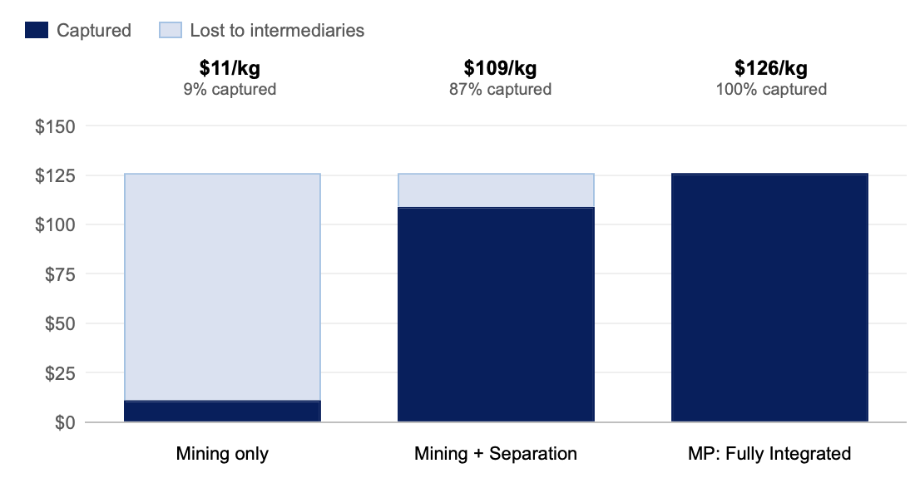
Investment Driver II – Total Control Over Supply Chain
MP Materials can increase price power through vertical integration from extraction to final manufacturing.
Phase I: Mining & Concentration (Already Completed) | Phase II: Ramping Separation Capacity (2022– Present) | Phase III: Finalizing Manufacturing Power (2022 – 2028+)
Successful Operation of Mountain Pass Mine in CA 2017: MP purchases the only rare earths mine in the US for $20.5 million and scales to 38,500 metric tons of production by 2020 (representing 15% of global rare earths production). No other competitor can compete without undergoing a 10-15 year mine development timeline | Operational Separation Capacity (US-First) Drives Margin Improvement 2022: Begins separating concentrated NdPr oxide at Mountain Pass. Output scales by 101% from 1,294 MT in 2024 to 2,599 MT in 2025, demonstrating a quickly scaling separation capacity. Fixed costs are being spread over a larger volume, allowing for margin improvement. Full Self-Sufficiency From China Drives Pricing Power Domestic separation capacity eliminates the need to ship to China and officially makes MP fully self-sufficient. This will allow MP to negotiate prices based on domestic contracts, not global economics. | Opening of Plant in Texas Marks Inflection Point 2025: MP’s first Texas magnet manufacturing plant (Independence) is online and producing over 3,000 MT of magnets per year. Prepayments from Apple and contracts with GM guarantee future cash flows. Planned Construction of Second Texas Plant Will Cement Supply Chain Control 2028: A second government-funded manufacturing plant will scale MP’s total production to over 10,000 MT. This represents an output no competitor can match within the next decade.
Revenue Capture Through Vertical Integration
$126/kg reflects the current market price of NdPr metal alloy as of April 2026
7
Notes:
https://seekingalpha.com/article/4295888-capital-structure-arbitrage-part-deux-curious-case-of-nio-inc
- Another graph of total shares issued

Slide 8
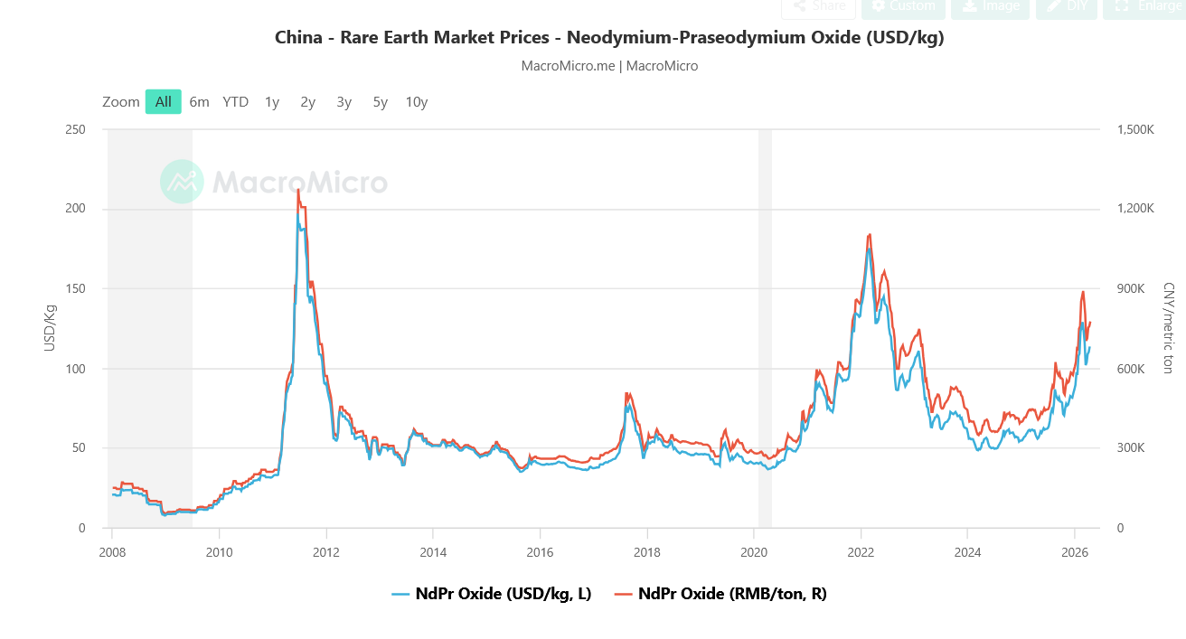
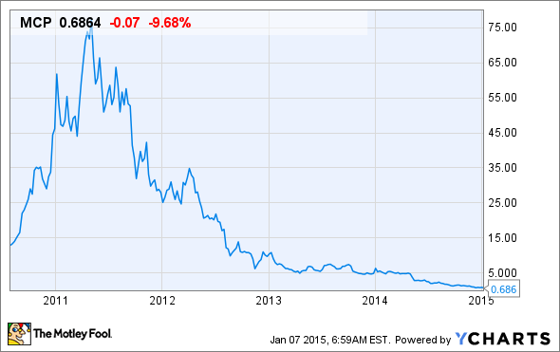



Investment Driver III – Policy as a Moat
Despite worries of MP Materials' vulnerability to price wars and supply drops, the US Government's support guarantees MP's dominance.
US and State Government Partnerships
Rare Earth Market Prices(Historical)
A 10-year $1B deal with the DoD in July 2025 provides MP Materials with a $110/kg price floor for NdPr products. This eliminates bankruptcy risk from China's predatory pricing derisking its valuation. MP's role in defense and with the US Government ensure its stability.
Federal grants for AI data center efficiently correlate with a rise in demand for MP's magnets. NdFeB magnets are critical in high-efficiency cooling fans. MP falls under Section 45X Advanced Manufacturing Tax Credits (10% of production cost). MP doesn't just have to rely on the EV and Defense industries but can utilize a high-margin AI infrastructure revenue stream.
MP Materials' magnet factory is located in Texas. MP has received upwards of $66M in grants to encourage scaling and development. In January 2026, Denton County Commissioners Court granted MP a 10-year tax break of 50% of real and personal property taxes. This pads MP's Stage III margins and ensures MP's magnets are cost-competitive with Chinese goods before factoring tariffs.
Molycorp (MCP) Comparison
Strategic Defense and Tech Infrastructure Peers
8
Notes:
Debt Composition
Interest Expense Composition
Debt Maturity Schedule
Notes

Slide 9
MP Materials exhibits highly volatile revenue, compressing margins, and declining profitability, reflecting strong sensitivity to rare earth pricing and cyclical market dynamics.
Financials - Income Statement Highlights
FY 2021 | FY 2022 | FY 2023 | FY 2024 | FY 2025
332.00 | 527.50 | 253.40 | 203.90 | 275.50
- | 58.89% | (51.96%) | (19.53%) | 35.12%
Revenue Growth:
Revenue growth is highly volatile, as it is seen to increase in FY 2022, before declining significantly in FY 2023-2024. However, it ultimately rebounds in FY 2025, which reflects sensitivity to rare earth pricing, instead of stable, consistent customer demand
Revenue
% Growth
Cost of Revenue: Operating
Gross Profit
% Margin
76.30 | 92.20 | 92.70 | 192.60 | 192.80
255.70 | 435.30 | 160.70 | 11.30 | 82.70
77.02% | 82.52% | 63.42% | 5.54% | 30.02%
Gross Margin:
Gross margin declined from 82.52% in FY2022 to 5.54% in 2024, before in recovered to 30.02% in FY2025. This indicates variability in cost structure relative to revenue.
Operating Expenses
Operating Income
% Margin
89.40 | 99.90 | 146.00 | 174.00 | 208.10
166.30 | 335.40 | 14.70 | (162.70) | (125.40)
50.09% | 63.58% | 5.80% | (79.79%) | (45.52%)
Operating Margin:
Operating margins go from strong profitability in FY2022 to negative levels in FY2024 and FY2025, due to a decline in revenue and a rise in operating expenses. This indicates earnings volatility and dependence on cyclical pricing dynamics.
EBITDA
% Margin
193.00 | 353.70 | 70.40 | (84.60) | (36.20)
58.13% | 67.05% | 27.78% | (41.49%) | (13.14%)
Volatility reflects transition from upstream mining to downstream manufacturing.
9
Notes:
Revenue Growth: revenue is dependent on mineral prices.
Gross Margin: the business makes a lot of money when prices are high, but struggles when prices fall because costs don’t fall as fast.
Operating Margin: The company’s profits go up and down a lot because they depend on changing market prices.
EBITDA: EBITDA margins decline sharply from strong levels (~67%) to negative in FY2024 before partially recovering, reinforcing the idea that core profitability is highly sensitive to fluctuations in rare earth prices.
While still negative overall, 2025 reflects a rebound from 2024, with improving revenue and margins indicating the business may be stabilizing after a cyclical downturn.

Slide 10
Financials - Balance Sheet Highlights
Assets | FY 2021 | FY 2022 | FY 2023 | FY 2024 | FY 2025
Cash | 1179.30 | 136.60 | 263.40 | 282.40 | 1166.00
Short Term Investments | 0.00 | 1045.70 | 734.50 | 568.40 | 664.30
Sum of Cash and ST&LT Investment | 1179.30 | 1182.30 | 997.90 | 850.80 | 1830.30
Liquidity
MP Materials has a strong position liquidity-wise, as their total cash and short-term investments were about 1.8B in FY2025 even after the prior declines. This shows that they have the flexibility and means to support operations and future investments
AR, Net | 51.00 | 32.90 | 10.00 | 18.60 | 13.60
Other Receivables | - | 2.50 | 21.00 | 44.30 | 132.00
Inventory | 38.70 | 57.60 | 95.20 | 107.90 | 171.60
Prepaid Expenses | 6.50 | 12.30 | 5.80 | 9.60 | 17.30
Restricted Cash | 1.30 | 6.30 | 1.30 | 0.00 | 0.00
Total Current Assets | 1276.80 | 1293.90 | 1131.20 | 1031.20 | 2164.80
Capital Investment
Net PP&E has significantly increased over this 5-year period, showing that there has been more investment in mining and process capacity to drive long-term production
Future Strategy/Risks
Total Assets almost doubled this period, showing aggressive expansion. This could also be a risk due to reliance on capital-intensive investments that may not generate consistent returns if commodity prices decline.
Net PP&E | 610.60 | 936.30 | 1168.70 | 1260.20 | 1383.00
Long Term Investments | 0.00 | 0.00 | 9.70 | 9.10 | 0.00
Other Long-Term Assets | 2.20 | 7.70 | 26.90 | 33.00 | 315.40
Total Assets | 1189.60 | 2237.90 | 2336.50 | 2333.50 | 3863.20
10
Notes:
Capital Investment: This is good because it positions the company to increase production and capture higher revenue when demand and prices for rare earth materials rise.
Future Strategy/Risks: So while this expansion increases risk, it also sets the company up for upside. Because they’ve invested heavily in capacity, when rare earth prices rise, they can produce and sell more at higher margins, which drives much stronger returns.”
Ratios: Current ratio (7.3) meaning good liquidity: Inventory turnover: 1.12 which means that it is still growing
“The sharp increase in cash and total current assets in FY2025 highlights improved liquidity and positions MP to fund growth and withstand cyclical downturns.”

Slide 11
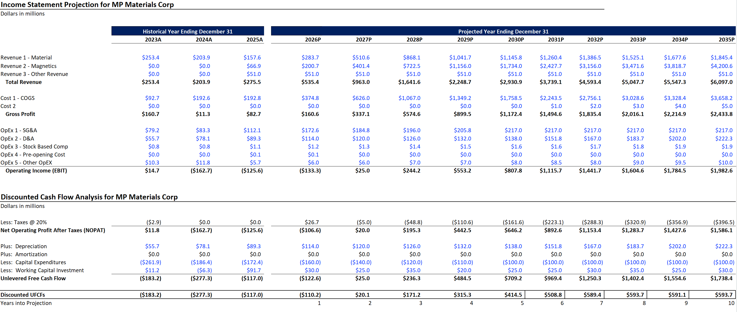
Valuation - DCF Analysis
Assuming a turnaround in the business by 2027
Discounted Cash Flow
11
Notes:
“We project revenue growing faster than costs due to operating leverage, where fixed costs are spread over higher production volumes, allowing margins to expand as the company scales.”
how much a company’s profits change when revenue changes, based on its cost structure.

Slide 12
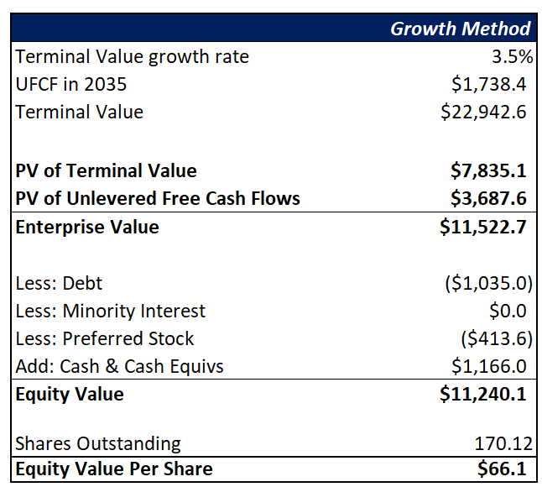
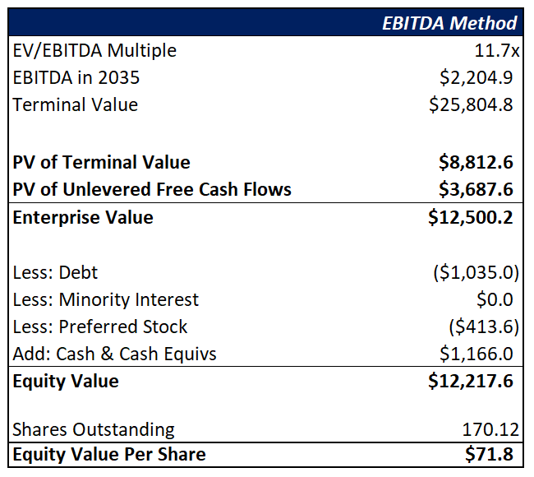
Valuation - DCF Analysis
Analysis:
Primary driver of DCF is revenue growth, which is driven by the ramp-up of the Magnetics segment and continued expansion in Materials.
If revenues are expected, the implied share price should be around $69.
Compared to current market price which is $60.99/share, the model suggests that the stock is right now is undervalued.

Slide 13
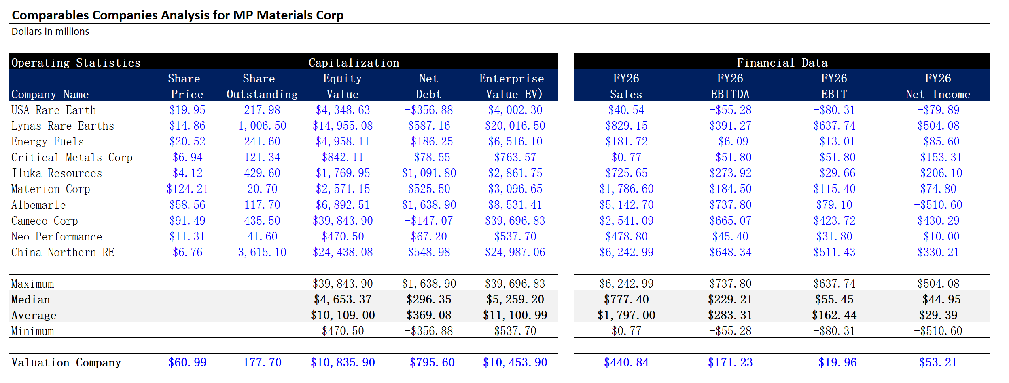
Appendix: Comps

Slide 14
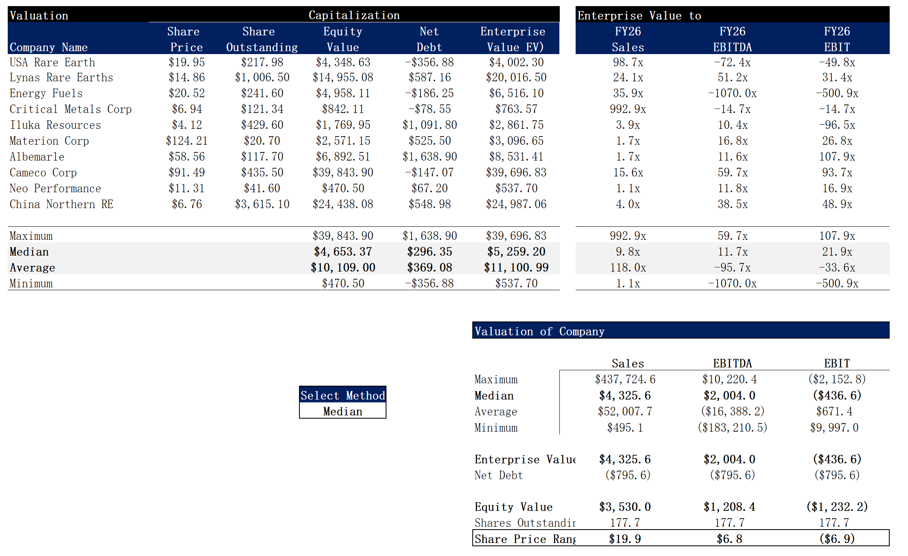
Appendix: Comps

Slide 15
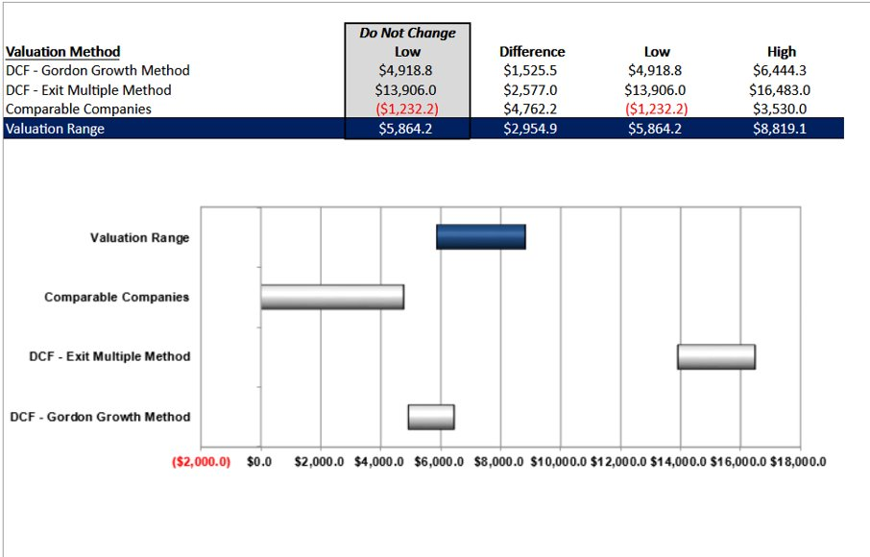
Appendix: Football Field

